Slide 1
Data Warehousing concepts

Slide 2
Why Data Warehouse?
Necessity is the mother of invention
Notes:
we invent something only if there is a need for that thing….today we are going to see what data warehousing is…data warehouse is evolved to satisfy some needs….we will see some of these need now

Slide 3
Scenario 1
ABC co. Ltd is a company with branches at Nairobi, Mombasa, Nakuru and Eldoret. The Sales Manager wants quarterly sales report. Each branch has a separate operational system.

Slide 4
Scenario 1 : ABC co. Ltd.
Nairobi
Nakuru
Sales per item type per branch
for first quarter.
Sales
Manager
Mombasa
Eldoret

Slide 5
Solution 1:ABC co. Ltd.
Extract sales information from each database.
Store the information in a common repository at a single site.

Slide 6
Solution 1:ABC co. Ltd.
Nairobi
Data
Warehouse
Report
Nakuru
Query &
Analysis tools
Sales
Manager
Mombasa
Eldoret

Slide 7
Scenario 2
One Stop Shopping Super Market has huge
operational database.Whenever Executives wants
some report the OLTP system becomes
slow and data entry operators have to wait for
some time.

Slide 8
Scenario 2 : One Stop Shopping
Data Entry Operator
Operational
Database
Report
Wait
Management
Data Entry Operator

Slide 9
Solution 2
Extract data needed for analysis from operational database.
Store it in warehouse.
Refresh warehouse at regular interval so that it contains up to date information for analysis.
Warehouse will contain data with historical perspective.

Slide 10
Solution 2
Data Entry
Operator
Operational
database
Data
Warehouse
Report
Extract
data
Transaction
Manager
Data Entry
Operator

Slide 11

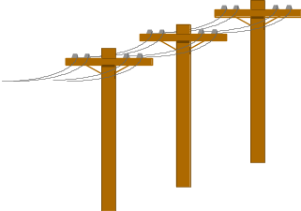


Problem: Heterogeneous Information Sources
“Heterogeneities are everywhere”
Personal
Databases
World
Wide
Web
Scientific Databases
Digital Libraries
Different interfaces
Different data representations
Duplicate and inconsistent information

Slide 12
Problem: Data Management in Large Enterprises
Vertical fragmentation of informational systems (vertical stove pipes)
Result of application (user)-driven development of operational systems
Sales Planning
Suppliers
Num. Control
Stock Mngmt
Debt Mngmt
Inventory
...
...
...
Sales Administration
Finance
Manufacturing
...

Slide 13


Goal: Unified Access to Data
Integration System
World
Wide
Web
Personal
Databases
Digital Libraries
Scientific Databases
Collects and combines information
Provides integrated view, uniform user interface
Supports sharing

Slide 14

Why a Warehouse?
Two Approaches:
  Query-Driven (Lazy)
  Warehouse (Eager)
?
Source
Source

Slide 15
The Warehousing Approach
Clients
Information integrated in advance
Stored in wh for direct querying and analysis
Data
Warehouse
Integration System
Metadata
. . .
Extractor/
Monitor
Extractor/
Monitor
Extractor/
Monitor
. . .
Source
Source
Source

Slide 16
Introduction
What is Data Warehouse?
A data warehouse is a collection of integrated databases designed to support a DSS.
According to Inmon’s (father of data warehousing) definition(Inmon,1992a,p.5):
  It is a collection of integrated, subject-oriented databases designed to support the DSS function, where each unit of data is non-volatile and relevant to some moment in time.

Slide 17

Inmon
Father of the data warehouse
Co-creator of the Corporate
Information Factory.
He has 35 years of
experience in database
technology management
and data warehouse design.

Slide 18
Inmon-Cont’d
Bill has written about a variety
of topics on the building, usage,
& maintenance of the data warehouse
& the Corporate Information Factory.
He has written more than 650
articles (Datamation, ComputerWorld,
and Byte Magazine).
Inmon has published 45 books.
  Many of books has been translated to Chinese, Dutch, French, German, Japanese, Korean, Portuguese, Russian, and Spanish.

Slide 19
Introduction-Cont’d.
Where is data warehousing used?
It is used for evaluating future strategy.
It needs a successful technician:
  Flexible.
  Team player.
  Good balance of business and technical understanding.

Slide 20
Introduction-Cont’d.
The ultimate use of data warehouse is Mass Customization.
  For example, it increased Capital One’s customers from 1 million to approximately 9 millions in 8 years.
Just like a muscle: DW increases in strength with active use.
  With each new test and product, valuable information is added to the DW, allowing the analyst to learn from the success and failure of the past.
The key to survival:
  Is the ability to analyze, plan, and react to changing business conditions in a much more rapid fashion.

Slide 21
Data Warehouse Evolution
Relational
Databases
Company
DWs
“Building the
DW”
Inmon (1992)
Data Replication
Tools
1960
1975
1980
1985
1990
1995
2000
Information-
Based
Management
“Prehistoric
Times”
“Middle
Ages”
Data
Revolution
TIME
PC’s and
Spreadsheets
End-user
Interfaces
1st DW
Article
DW
Confs.
Vendor DW
Frameworks

Slide 22
Warehouse is a Specialized DB
Standard DB (OLTP)
Mostly updates
Many small transactions
Mb - Gb of data
Current snapshot
Index/hash on p.k.
Raw data
Thousands of users (e.g., clerical users)
Warehouse (OLAP)
Mostly reads
Queries are long and complex
Gb - Tb of data
History
Lots of scans
Summarized, reconciled data
Hundreds of users (e.g., decision-makers, analysts)
CS 336

Slide 23
OLTP vs. OLAP
OLTP: On Line Transaction Processing
  Describes processing at operational sites
OLAP: On Line Analytical Processing
  Describes processing at warehouse
CS 336

Slide 24
Data Warehouse
In order for data to be effective, DW must be:
  Consistent.
  Well integrated.
  Well defined.
  Time stamped.
DW environment:
  The data store, data mart & the metadata.

Slide 25
The Data Store
An operational data store (ODS) stores data for a specific application. It feeds the data warehouse a stream of desired raw data.
Is the most common component of DW environment.
Data store is generally subject oriented, volatile, current commonly focused on customers, products, orders, policies, claims, etc…

Slide 26
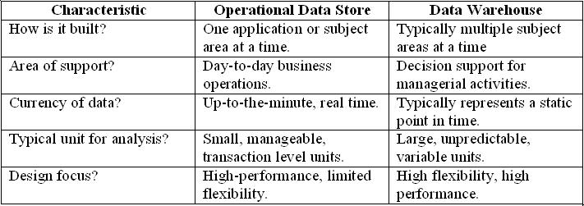
Data Store & Data Warehouse
Data store & Data warehouse table

Slide 27
The data store-Cont’d.
Its day-to-day function is to store the data for a single specific set of operational application.
Its function is to feed the data warehouse data for the purpose of analysis.

Slide 28
The Data Mart
It is lower-cost, scaled down version of the DW.
Data Mart offer a targeted and less costly method of gaining the advantages associated with data warehousing and can be scaled up to a full DW environment over time.

Slide 29
The Meta Data
Last component of DW environments.
It is information that is kept about the warehouse rather than information kept within the warehouse.
Legacy systems generally don’t keep a record of characteristics of the data (such as what pieces of data exist and where they are located).
The metadata is simply data about data.

Slide 30
Characteristics of Data Warehouse
Summarized Operational data are mapped into a decision-usable format
Large volume. Time series data sets are normally quite large.
Not normalized. DW data can be, and often are, redundant.
Metadata. Data about data are stored.
Data sources. Data come from internal and external unintegrated operational systems.

Slide 31
Inmons’s definition
A data warehouse is
-subject-oriented,
-integrated,
-time-variant,
-nonvolatile
collection of data in support of management’s
decision making process.

Slide 32
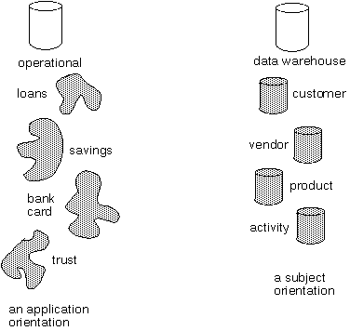
Subject-oriented
Data warehouse is organized around subjects such as sales,product,customer.
It focuses on modeling and analysis of data for decision makers.
Excludes data not useful in decision support process.

Slide 33
Data Integrated
Integration –consistency naming conventions and measurement attributers, accuracy, and common aggregation.
Establishment of a common unit of measure for all synonymous data elements from dissimilar database.
The data must be stored in the DW in an integrated, globally acceptable manner

Slide 34
Integration
Data Warehouse is constructed by integrating multiple heterogeneous sources.
All inconsistencies regarding naming convention and value representations are removed.
Data Preprocessing are applied to ensure consistency.
RDBMS
Data
Warehouse
Legacy
System
Flat File
Data Processing
Data Transformation

Slide 35
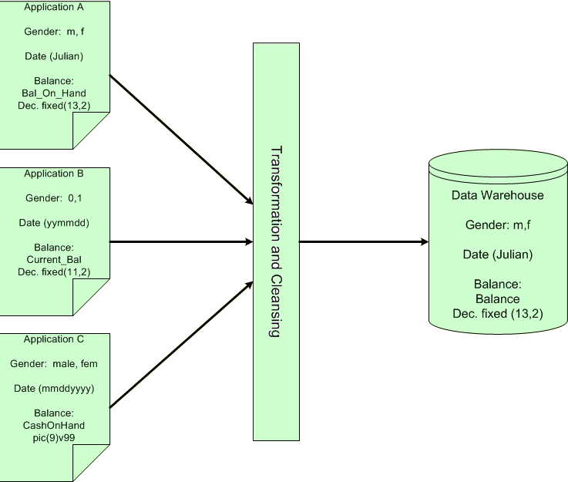
Data Integrated

Slide 36
Nonvolatile
Data once recorded cannot be updated.
Data are stored in read-only format and do not change over time.
Data warehouse requires two operations in data accessing
  Initial loading of data
  Access of data
load
access

Slide 37
Nonvolatility
Typical activities such as deletes, inserts, and changes that are performed in an operational application environment are completely nonexistent in a DW environment.
Only two data operations are ever performed in the DW: data loading and data access

Slide 38
Time-variant
Provides information from historical perspective e.g. past 5-10 years
Every key structure contains either implicitly or explicitly an element of time

Slide 39
Time Variant
Every piece of data contained within the warehouse must be associated with a particular point in time if any useful analysis is to be conducted with it.
Another aspect of time variance in DW data is that, once recorded, data within the warehouse cannot be updated or changed.

Slide 40
Issues of Data Redundancy between DW and operational environments
The data being loaded into the DW are filtered and “cleansed” as they pass from the operational database to the warehouse. Because of this cleansing numerous data that exists in the operational environment never pass to the data warehouse. Only the data necessary for processing by the DSS or EIS are ever actually loaded into the DW.
The time horizons for warehouse and operational data elements are unique. Data in the operational environment are fresh, whereas warehouse data are generally much older.(so there is minimal opportunity of the data to overlap between two environments )
The data loaded into the DW often undergo a radical transformation as they pass form operational to the DW environment. So data in DW are not the same.
Given this factors, Inmon suggests that data redundancy between the two environments is a rare occurrence with a typical redundancy factor of less than 1 %

Slide 41
Data Warehouse Schema
Star Schema
Fact Constellation Schema
Snowflake Schema
Notes:
We need subject oriented and multidimensional data amodel fro data warehouse which facilitates online analysis

Slide 42
Star Schema
A single,large and central fact table and one table for each dimension.
Every fact points to one tuple in each of the dimensions and has additional attributes.
Does not capture hierarchies directly.

Slide 43
Star Schema (contd..)
Store Dimension
Fact Table
Time Dimension
Store Key
Store Name
City
State
Region
Store Key
Product Key
Period Key
Units
Price
Period Key
Year
Quarter
Month
Product Key
Product Desc
Product Dimension
Benefits: Easy to understand, easy to define hierarchies, reduces no. of physical
joins.

Slide 44
SnowFlake Schema
Variant of star schema model.
A single,large and central fact table and one or more tables for each dimension.
Dimension tables are normalized i.e. split dimension table data into additional tables

Slide 45
SnowFlake Schema (contd..)
Store Dimension
Fact Table
Time Dimension
Store Key
Product Key
Period Key
Units
Price
Period Key
Year
Quarter
Month
Store Key
Store Name
City Key
City Dimension
City Key
City
State
Region
Product Key
Product Desc
Product Dimension
Drawbacks: Time consuming joins,report generation slow

Slide 46
Fact Constellation
Multiple fact tables share dimension tables.
This schema is viewed as collection of stars hence called galaxy schema or fact constellation.
Sophisticated application requires such schema.

Slide 47
Fact Constellation (contd..)
Sales
Fact Table
Shipping
Fact Table
Store Key
Product Key
Period Key
Units
Price
Product Dimension
Shipper Key
Store Key
Product Key
Period Key
Units
Price
Product Key
Product Desc
Store Dimension
Store Key
Store Name
City
State
Region

Slide 48
The Data Warehouse Architecture
The architecture consists of various interconnected elements:
  Operational and external database layer – the source data for the DW
  Information access layer – the tools the end user access to extract and analyze the data
  Data access layer – the interface between the operational and information access layers
  Metadata layer – the data directory or repository of metadata information

Slide 49
The Data Warehouse Architecture
Additional layers are:
  Process management layer – the scheduler or job controller
  Application messaging layer – the “middleware” that transports information around the firm
  Physical data warehouse layer – where the actual data used in the DSS are located
  Data staging layer – all of the processes necessary to select, edit, summarize and load warehouse data from the operational and external data bases

Slide 50
Generic Warehouse Architecture
Client
Client
Query & Analysis
Design Phase
Loading
Warehouse
Metadata
Maintenance
Integrator
Optimization
Extractor/
Monitor
Extractor/
Monitor
Extractor/
Monitor
...
CS 336

Slide 51
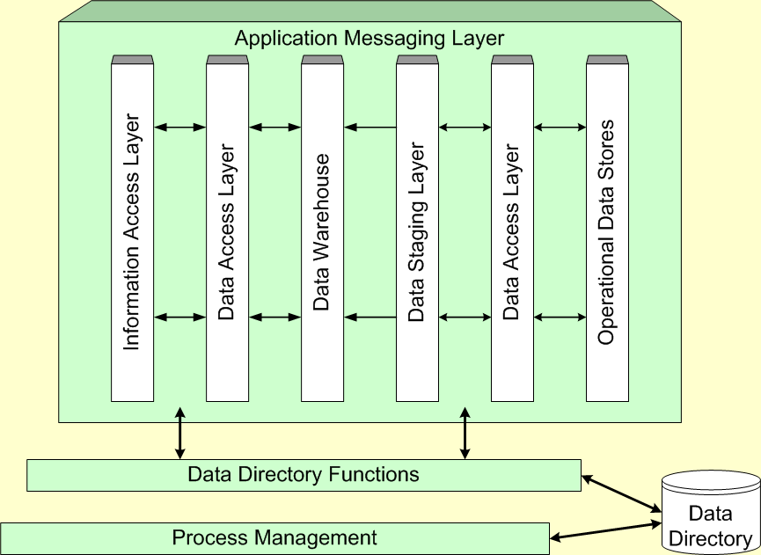
Components of the Data Warehouse Architecture

Slide 52
Data Warehousing Typology
The virtual data warehouse – the end users have direct access to the data stores, using tools enabled at the data access layer
The central data warehouse – a single physical database contains all of the data for a specific functional area
The distributed data warehouse – the components are distributed across several physical databases

Slide 53
The Metadata
Metadata is “data about data”.
With the emergence of the data warehouse as a decision support structure, the metadata are considered as much a resource as the business data they describe.
Metadata are abstractions -- they are high level data that provide concise descriptions of lower-level data.

Slide 54
The Metadata
For example, a line in a sales database may contain: 4056 KJ596 223.45
This is mostly meaningless until we consult the metadata that tells us it was store number 4056, product KJ596 and sales of $223.45
The metadata are essential ingredients in the transformation of raw data into knowledge. They are the “keys” that allow us to handle the raw data.

Slide 55
General Metadata Issues
General metadata issues associated with Data Warehouse use:
  What tables, attributes and keys does the DW contain?
  Where did each set of data come from?
  What transformations were applied with cleansing?
  How have the metadata changed over time?
  How often do the data get reloaded?
  Are there so many data elements that you need to be careful what you ask for?

Slide 56
Components of the Metadata
Transformation maps – records that show what transformations were applied
Extraction & relationship history – records that show what data was analyzed
Algorithms for summarization – methods available for aggregating and summarizing
Data ownership – records that show origin
Patterns of access – records that show what data are accessed and how often

Slide 57
Role of Metadata (data catalog)
Identify subjects of the data mart
Identify dimensions and facts
Indicate how data is derived from enterprise data warehouses, including derivation rules
Indicate how data is derived from operational data store, including derivation rules
Identify available reports and predefined queries
Identify data analysis techniques (e.g. drill-down)
Identify responsible people

Slide 58
Typical Mapping Metadata
Transformation mapping records include:
  Identification of original source
  Attribute conversions
  Physical characteristic conversions
  Encoding/reference table conversions
  Naming changes
  Key changes
  Values of default attributes
  Logic to choose from multiple sources
  Algorithmic changes

Slide 59

Building a Data Warehouse
Data Warehouse Lifecycle
  Analysis
  Design
  Import data
  Install front-end tools
  Test and deploy

Slide 60
Stage 1: Analysis
  Analysis
  Design
  Import data
  Install front-end tools
  Test and deploy
Identify:
  Target Questions
  Data needs
  Timeliness of data
  Granularity
Create an enterprise-level data dictionary
Dimensional analysis
  Identify facts and dimensions

Slide 61
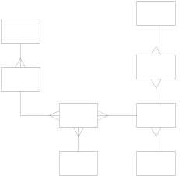
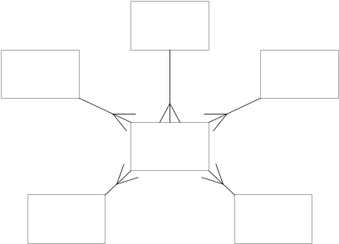
Stage 2: Design
  Analysis
  Design
  Import data
  Install front-end tools
  Test and deploy
Star schema
Data Transformation
Aggregates
Pre-calculated Values
HW/SW Architecture
Dimensional Modeling

Slide 62
Dimensional Modeling
Fact Table – The primary table in a dimensional model that is meant to contain measurements of the business.
Dimension Table – One of a set of companion tables to a fact table. Most dimension tables contain many textual attributes that are the basis for constraining and grouping within data warehouse queries.
SOURCE: Ralph Kimball

Slide 63
Stage 3: Import Data
Identify data sources
Extract the needed data from existing systems to a data staging area
Transform and Clean the data
  Resolve data type conflicts
  Resolve naming and key conflicts
  Remove, correct, or flag bad data
  Conform Dimensions
Load the data into the warehouse
  Analysis
  Design
  Import data
  Install front-end tools
  Test and deploy

Slide 64
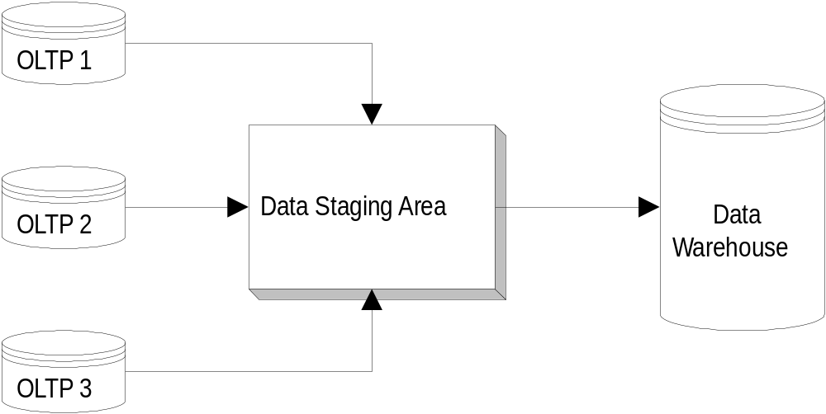
Importing Data Into the Warehouse
Operational Systems
(source systems)

Slide 65

Stage 4: Install Front-end Tools
  Analysis
  Design
  Import data
  Install front-end tools
  Test and deploy
Reporting tools
Data mining tools
GIS
Etc.

Slide 66
Stage 5: Test and Deploy
  Analysis
  Design
  Import data
  Install front-end tools
  Test and deploy
Usability tests
Software installation
User training
Performance tweaking based on usage

Slide 67

Special Concerns
Time and expense
Managing the complexity
Update procedures and maintenance
Changes to source systems over time
Changes to data needs over time

Slide 68
Implementing the Data Warehouse
Kozar list of “seven deadly sins” of data warehouse implementation:
  “If you build it, they will come” – the DW needs to be designed to meet people’s needs
  Omission of an architectural framework – you need to consider the number of users, volume of data, update cycle, etc.
  Underestimating the importance of documenting assumptions – the assumptions and potential conflicts must be included in the framework

Slide 69
“Seven Deadly Sins”, continued
  Failure to use the right tool – a DW project needs different tools than those used to develop an application
  Life cycle abuse – in a DW, the life cycle really never ends
  Ignorance about data conflicts – resolving these takes a lot more effort than most people realize
  Failure to learn from mistakes – since one DW project tends to beget another, learning from the early mistakes will yield higher quality later

Slide 70
Data Warehouse Technologies
No one currently offers an end-to-end DW solution. Organizations buy bits and pieces from a number of vendors and hopefully make them work together.
SAS, IBM, Software AG, Information Builders and Platinum offer solutions that are at least fairly comprehensive.
The market is very competitive.

Slide 71
The User Interface
A variety of tools are available to query and analyze data stored in data warehouses.
  1. Querying tools
  2. On-line Analytical processing (OLAP, MOLAP, ROLAP) tools
  3. Data Mining tools
  4. Data Visualization tools

Slide 72
Querying Tools
SQL is not an analytical language
SQL-99 includes some data warehousing extensions
SQL-99 still is not a full-featured data warehouse querying and analysis tool.
Different DBMS vendors will implement some or all of the SQL-99 OLAP extension commands and possibly others.

Slide 73
Online Analysis Processing(OLAP)
It enables analysts, managers and executives to gain insight into data through fast, consistent, interactive access to a wide variety of possible views of information that has been transformed from raw data to reflect the real dimensionality of the enterprise as understood by the user.
Product
Data
Warehouse
Region
Time

Slide 74
On-Line Analytical Processing (OLAP)
OLAP is the use of a set of graphical tools that provides users with multidimensional views of their data and allows them to analyze the data using simple windowing techniques
Relational OLAP (ROLAP)
  OLAP tools that view the database as a traditional relational database in either a star schema or other normalized or denormalized set of tables.
Multidimensional OLAP (MOLAP)
  OLAP tools that load data into an intermediate structure, usually a three or higher dimensional array. (Cube structure)

Slide 75
From tables to data cubes
A data warehouse is based on a multidimensional data model which views data in the form of a data cube
A data cube, such as sales, allows data to be modeled and viewed in multiple dimensions
  Dimension tables, such as item (item_name, brand, type), or time (day, week, month, quarter, year)
  Fact table contains measures (such as dollars_sold) and keys to each of the related dimension tables

Slide 76
MOLAP Operations
Roll up (drill-up): summarize data
  by climbing up hierarchy or by dimension reduction
Drill down (roll down): reverse of roll-up
  from higher level summary to lower level summary or detailed data, or introducing new dimensions
Slice and dice:
  Selection on one dimension; selection on more than one dimension respectively

Slide 77
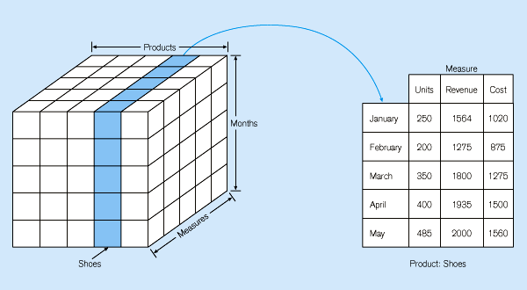
Figure 11-22: Slicing a data cube

Slide 78
OLAP Operations
Drill Down
Product
Category e.g Electrical Appliance
Sub Category e.g Kitchen
Product e.g Toaster
Region
Time

Slide 79
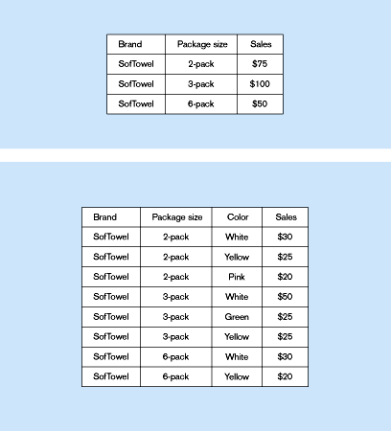
Summary report
Example of drill-down
Drill-down with color added

Slide 80
OLAP Operations
Drill Up
Product
Category e.g Electrical Appliance
Sub Category e.g Kitchen
Product e.g Toaster
Region
Time

Slide 81
OLAP Server
An OLAP Server is a high capacity,multi user data manipulation engine specifically designed to support and operate on multi-dimensional data structure.
OLAP server available are
  MOLAP server
  ROLAP server
  HOLAP server

Slide 82
OLAP Operations
Slice and Dice
Product
Product=Toaster
Region
Region
Time
Time

Slide 83
Presentation
Product
Reporting
Tool
Region
Report
Time

Slide 84
Data Warehousing includes
Build Data Warehouse
Online analysis processing(OLAP).
Presentation.
Cleaning ,Selection &
Integration
RDBMS
Presentation
Flat File
Client
Warehouse & OLAP server

Slide 85
Data Warehousing Tools
Data Warehouse
  SQL Server 2000 DTS
  Oracle 8i Warehouse Builder
OLAP tools
  SQL Server Analysis Services
  Oracle Express Server
Reporting tools
  MS Excel Pivot Chart
  VB Applications

Slide 86
The Future of Data Warehousing
As the DW becomes a standard part of an organization, there will be efforts to find new ways to use the data. This will likely bring with it several new challenges:
  Regulatory constraints may limit the ability to combine sources of disparate data.
  These disparate sources are likely to contain unstructured data, which is hard to store.
  The Internet makes it possible to access data from virtually “anywhere”. Of course, this just increases the disparity.

